Slide 1

Data Engineering with Disney
Present By: Alexandria Morales-Garcia

Slide 2
How is a Relational Database Management System (RDBMS) going to save us time and money?
Can use SQL to cut down query time dramatically
Multiple people can access the data without worry of someone altering it
Can be expensive/ impossible to recover data
Prepped for data analysis and data visuals
Data is ready to use with no time wasted
Get ahead on an inevitable problem
More data you have the harder it is to manage without a database
More data would also take more time to upload into a database

Slide 3

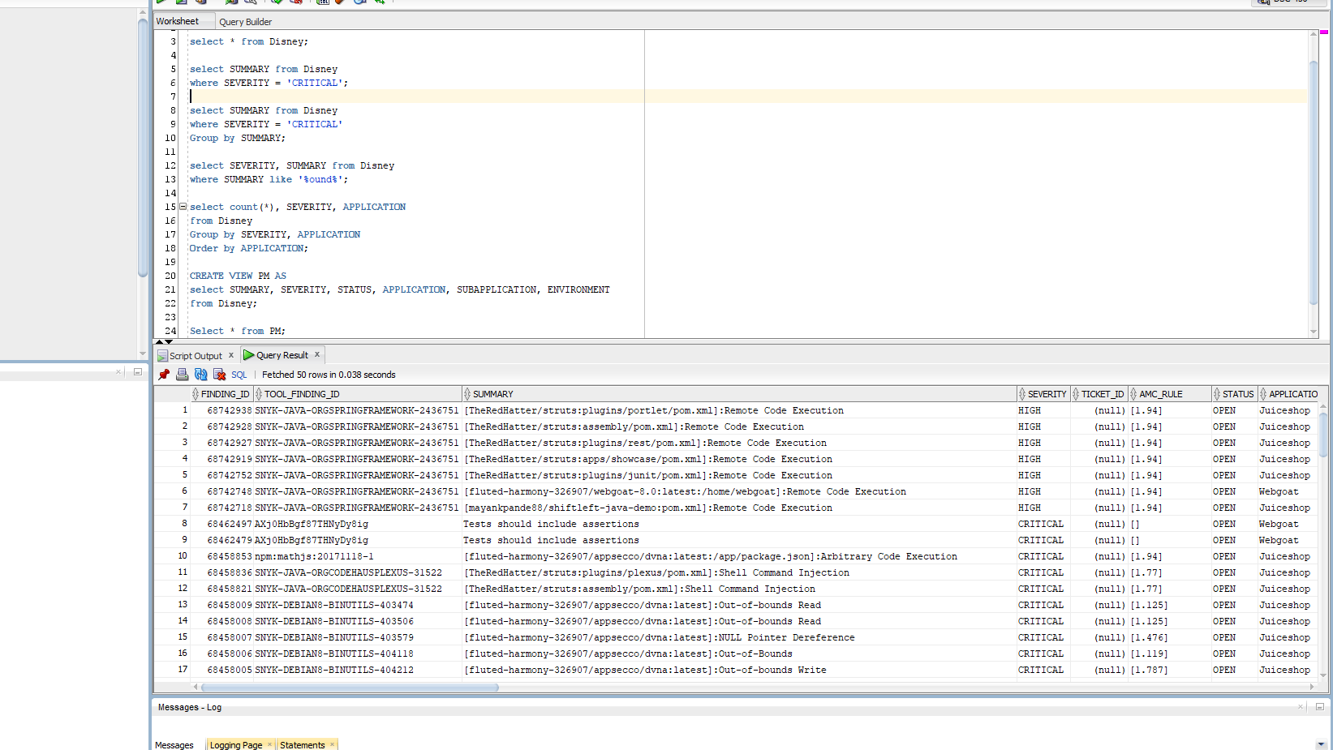



Database Tutorial

Slide 4
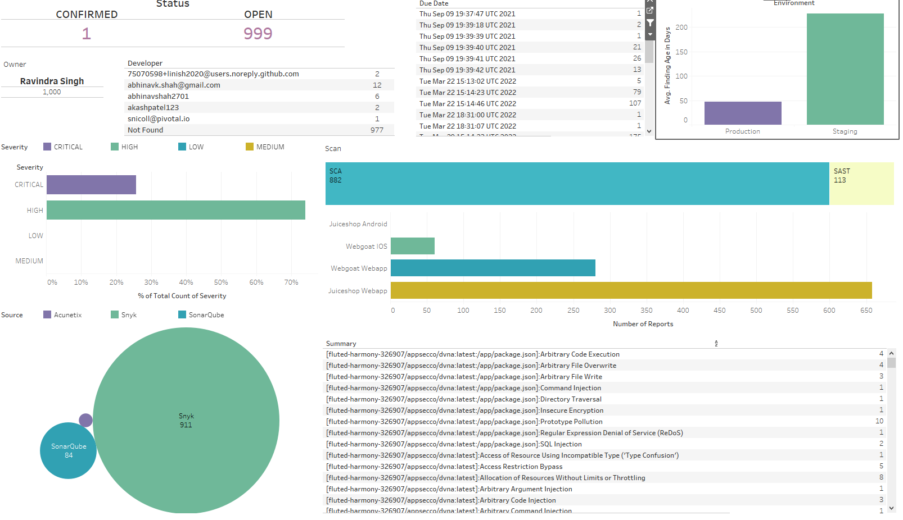
Dashboard Example

Slide 5
Project Milestones
Months 0
Learning the data, the team, data uses (types of queries regularly used), build the schema, set up storing “rules” for each column
Month 1 and 2
Month 3 and 4
Buy a RDMS, Clean the data, Create Tables, Clean the data, Move the data over, Clean the data
Automate the Data, Host SQL Lunch and Learns
Month 5
Creating Dashboards/ Data Visuals
Live Dashboards
Data Stored In RDMS

Slide 6
Possible Further Project
Find Hidden Stories
Factor Analysis
Principal Component Analysis
Cluster Analysis
Predict
How long would it take us to find an error?
Classify
Can you classify the severity without knowing the exact error?

